Slide 1
E WEB Creators
PHASE 2
CSP-584
Enterprise Web Application
Parth Patel A20405581
Krunal Sevak A20405875
Pradyot Mayank A20405826

Slide 2
Overview
Submit Requirements
Wait For Approval & Get Quote
Get Live Project Status
Make Payment
Ready to Deploy!

Slide 3








High Level Model
BDO
PM
Admin
Client
Request
Approved/Reject
Approved/Reject
Accept/Reject
MySQL Databse
Project Details
Write Suggestions
Project Details, Registration, Project Table
View Suggestions
Client

Slide 4

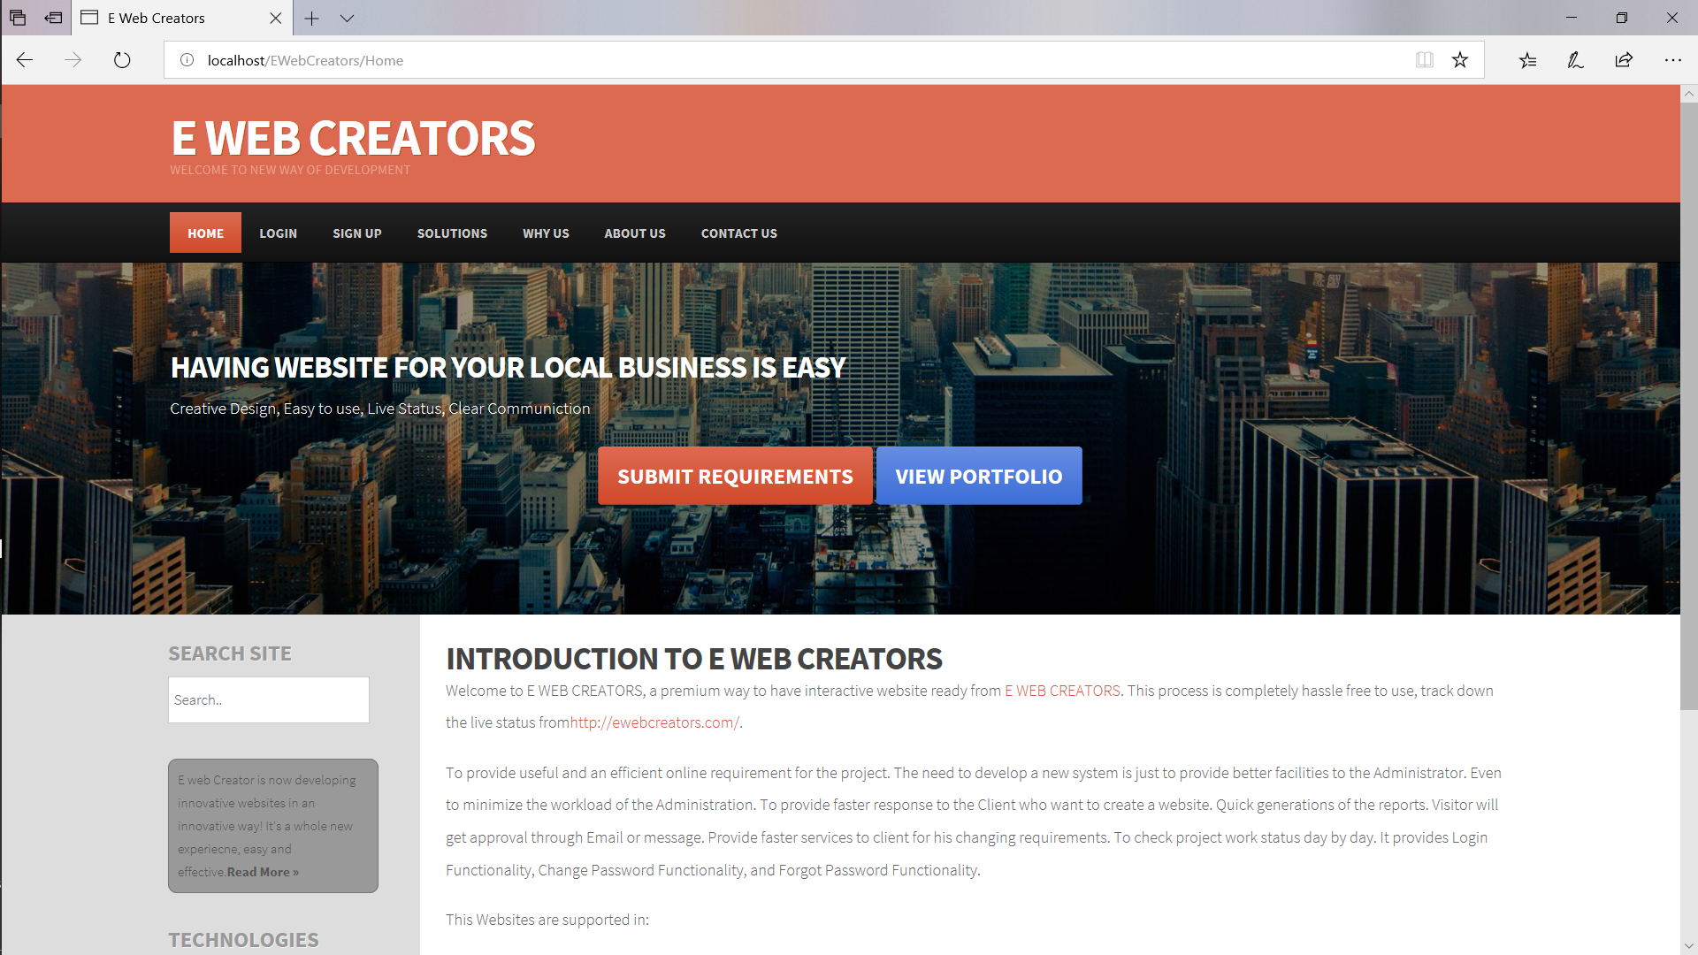
Home Page

Slide 5
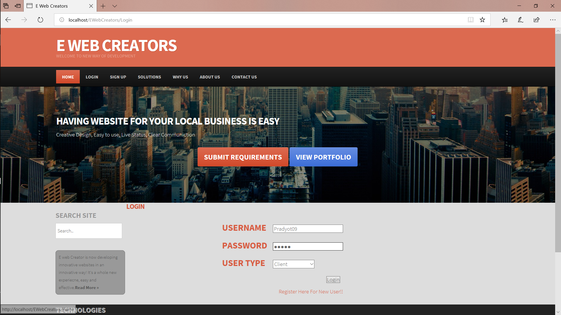
Login Page

Slide 6
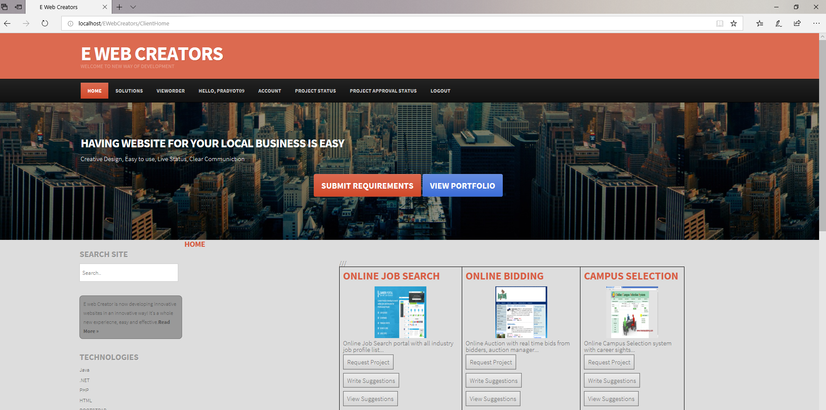
Client Home Page

Slide 7
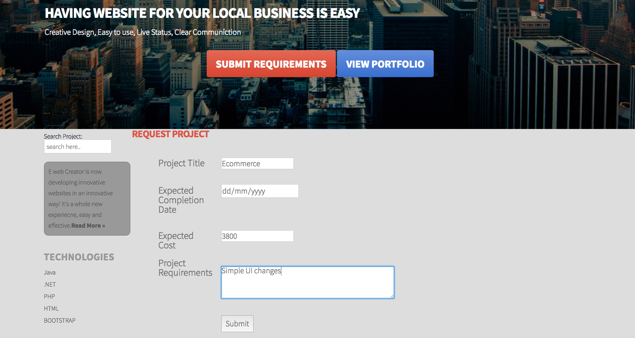
Client Project Request

Slide 8
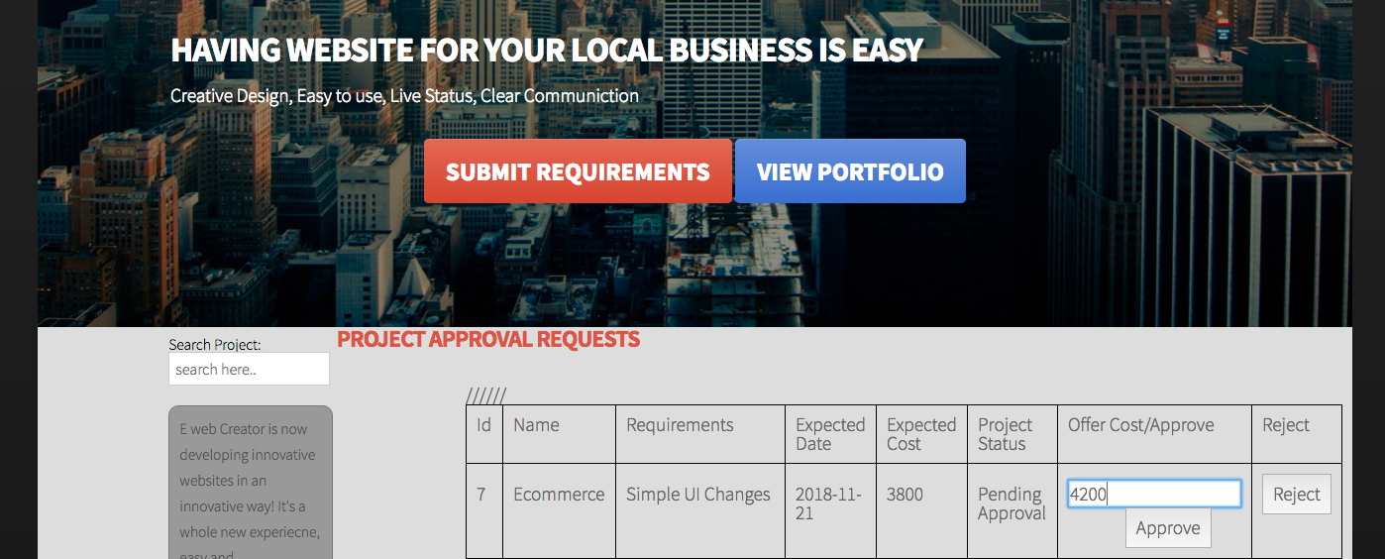
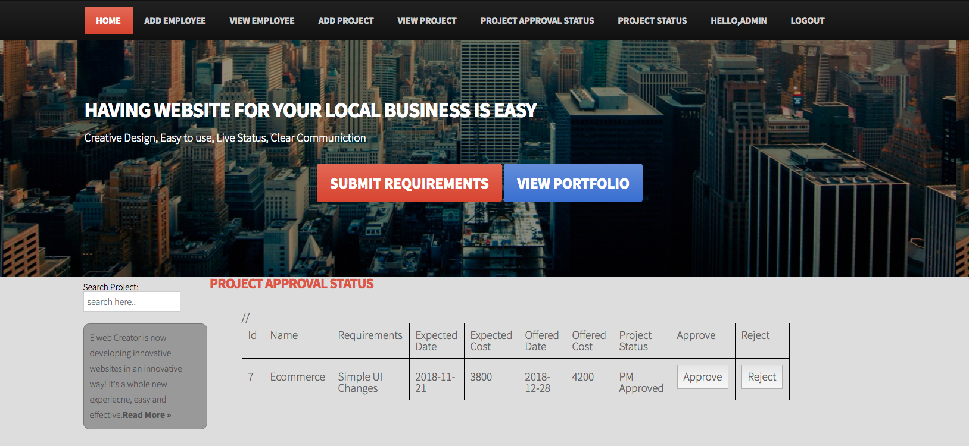
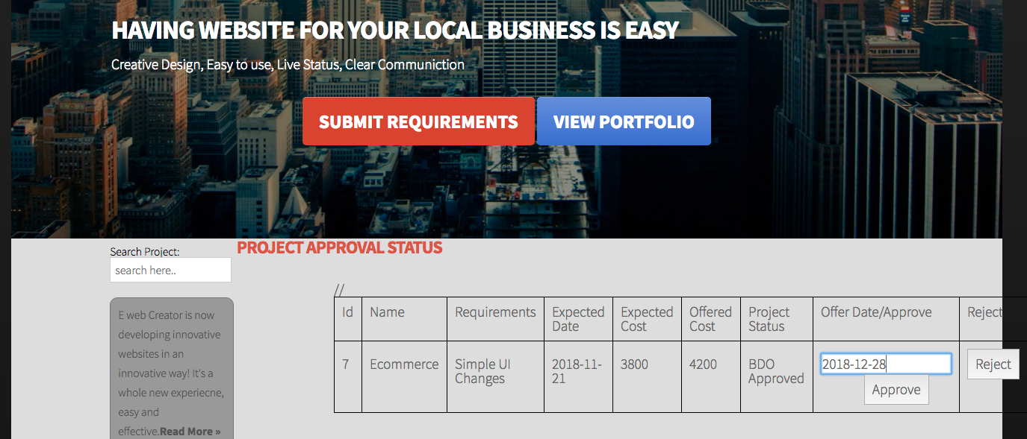
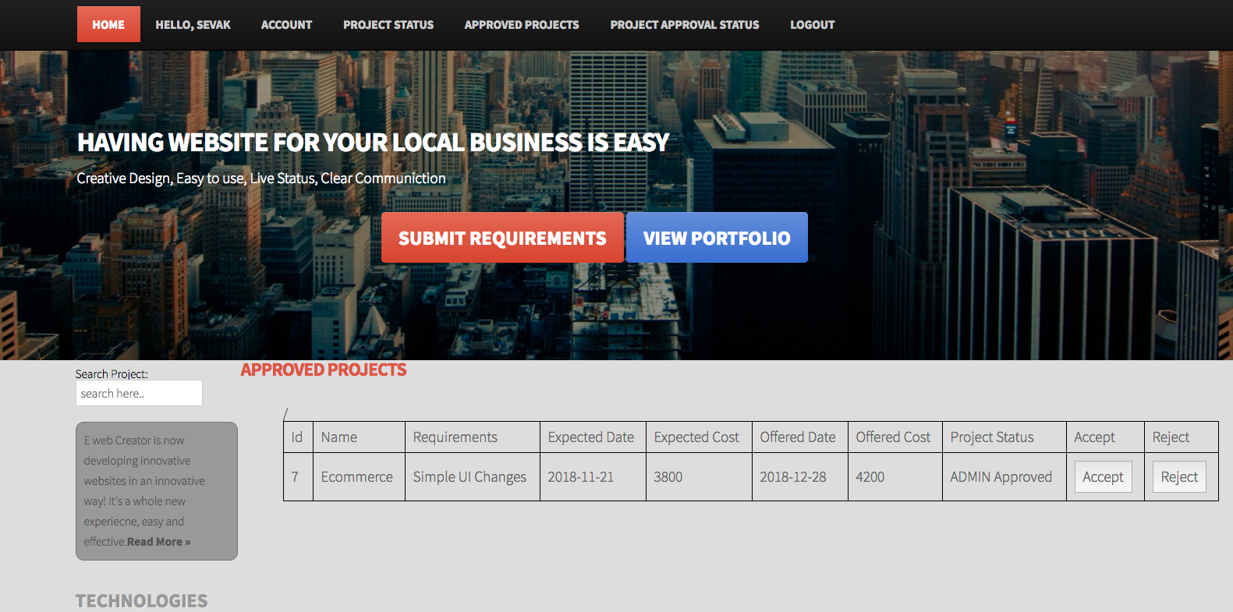
Project Request Flow

Slide 9
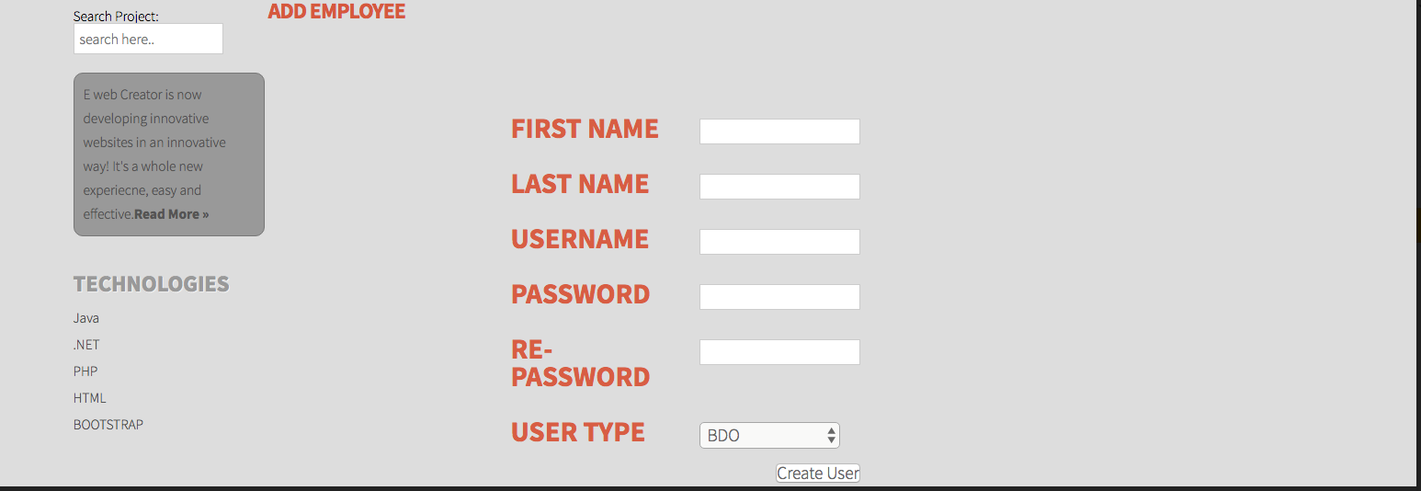
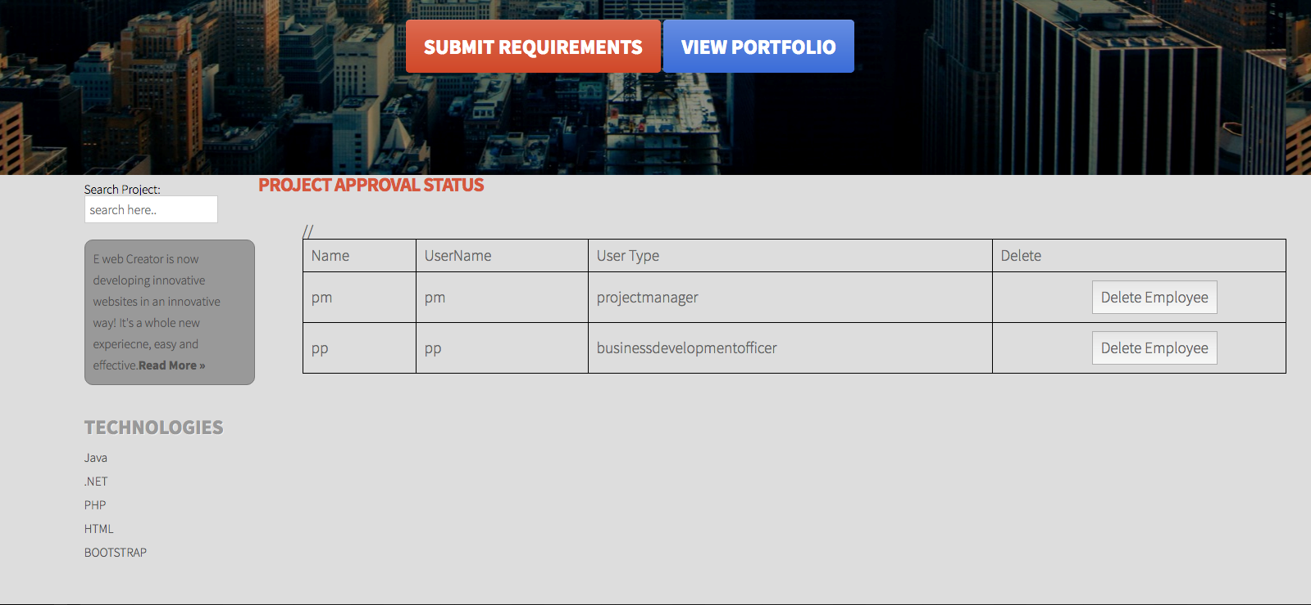
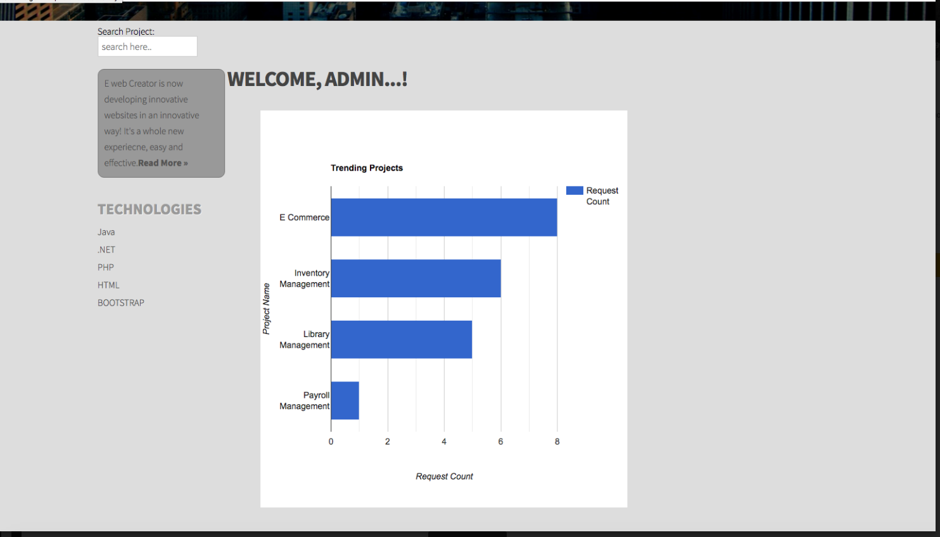
Admin Home Page

Slide 10
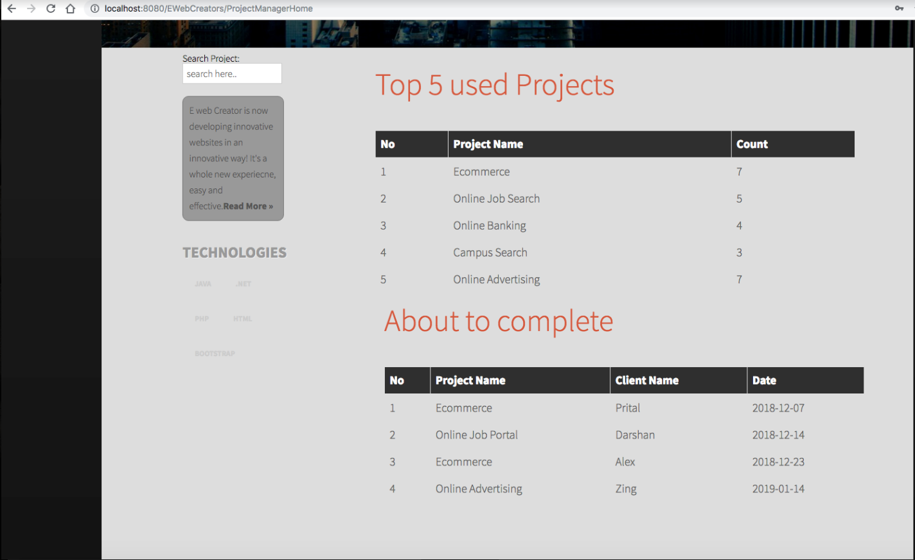
Project Manager Home Page

Slide 11
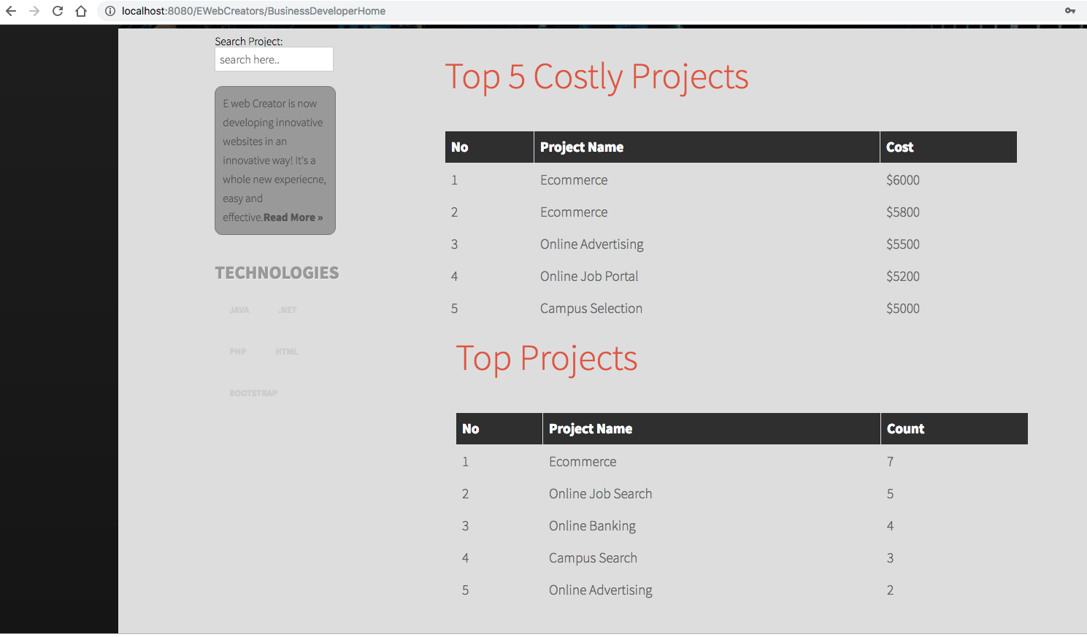
Business Developer Home

Slide 12
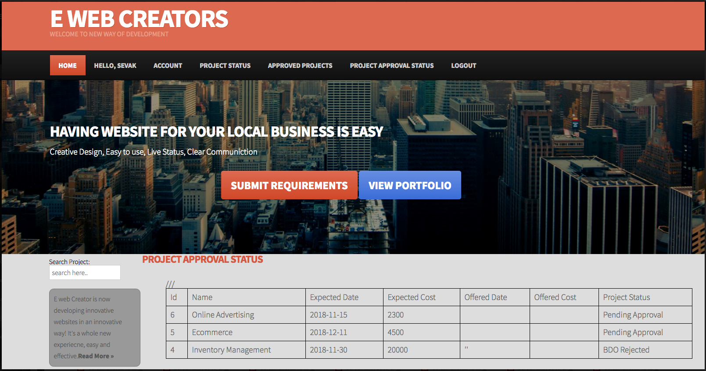
Project Approval Status Page

Slide 13
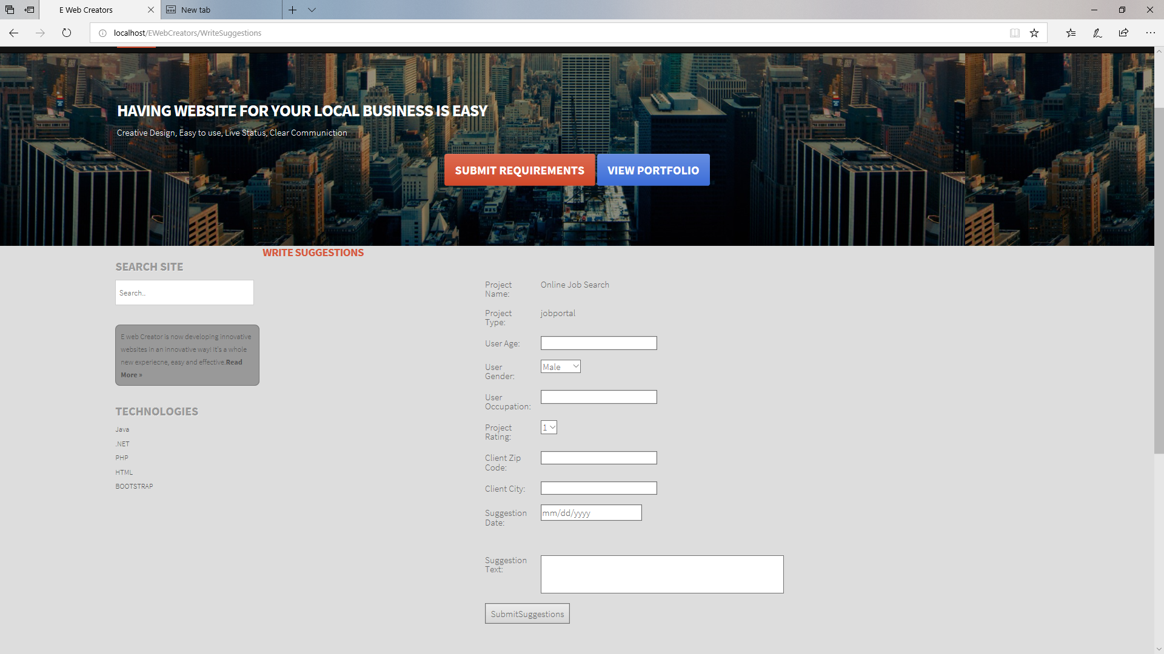
Write Suggestions Feature

Slide 14
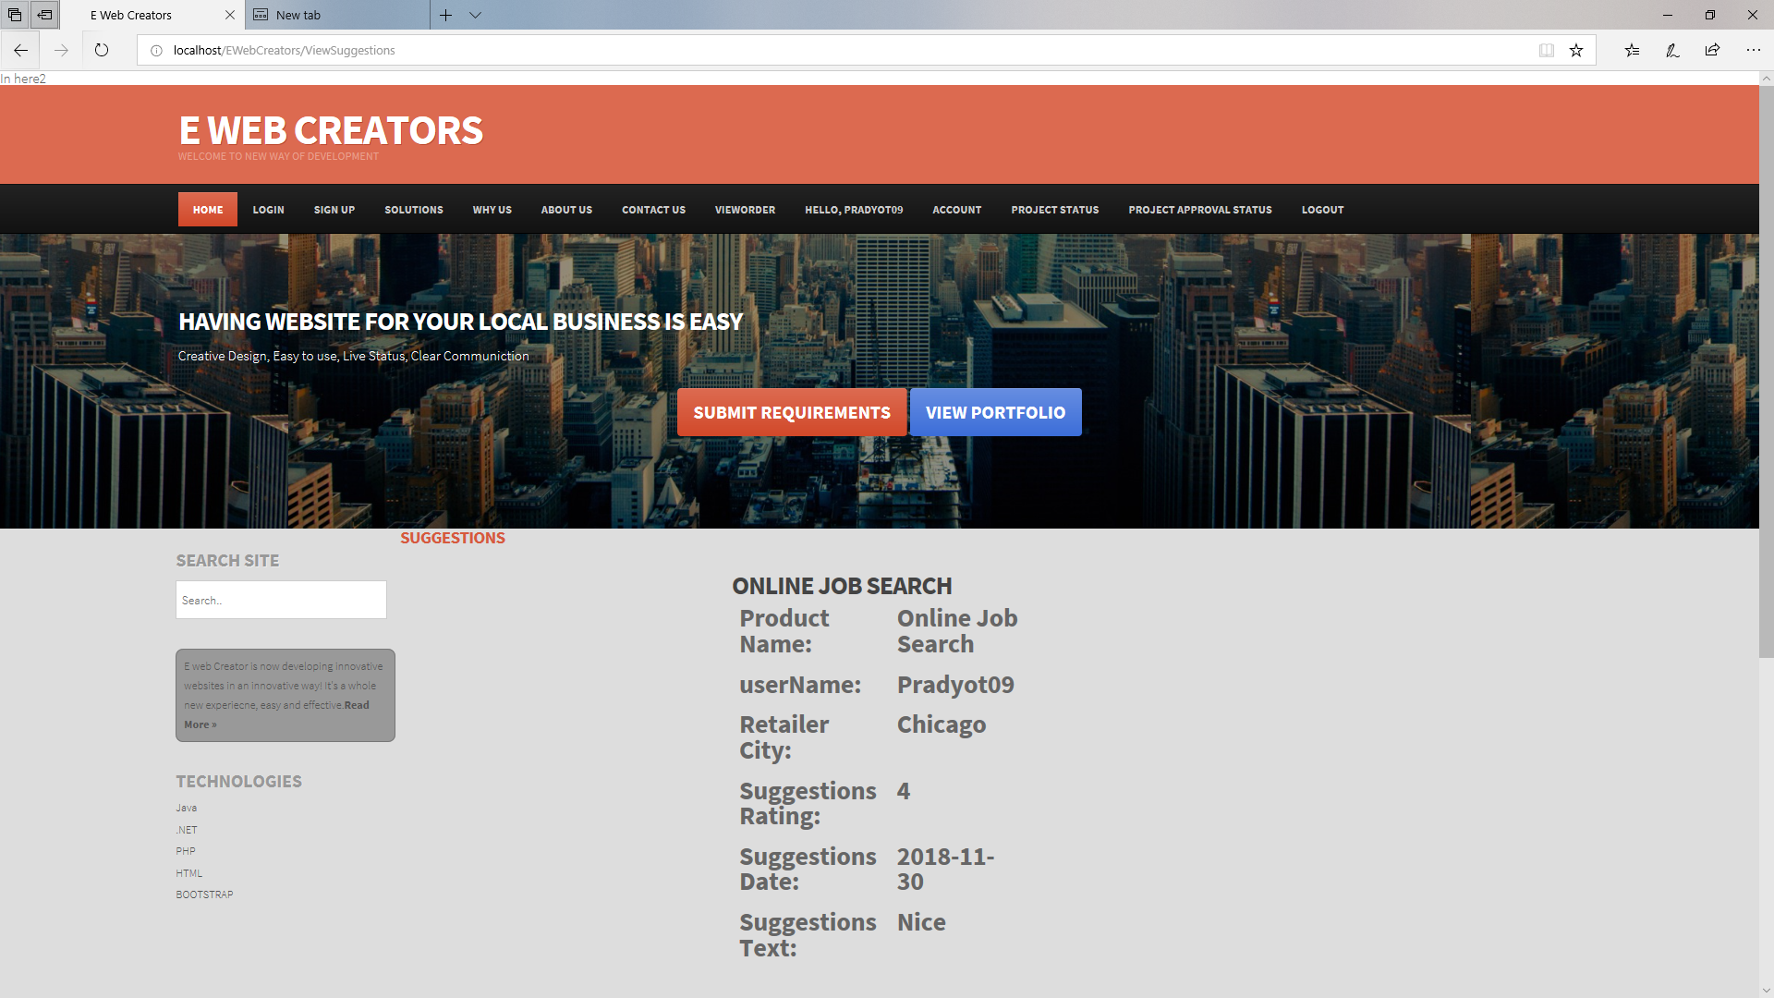
View Suggestions Feature

Slide 15
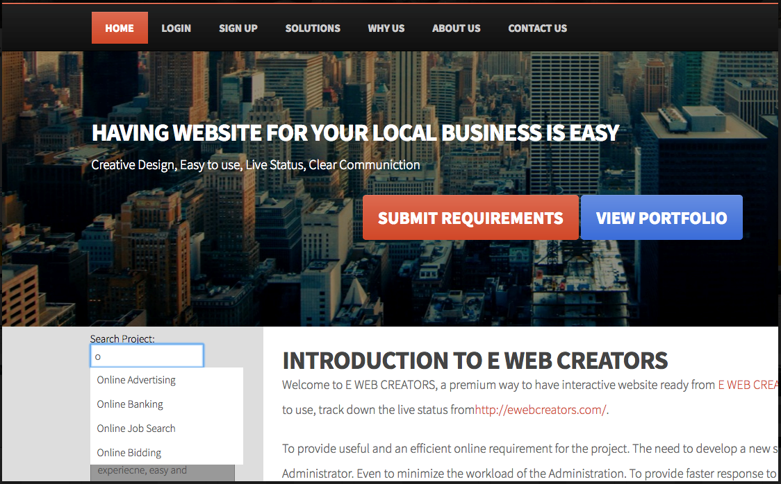
Search Feature

Slide 16
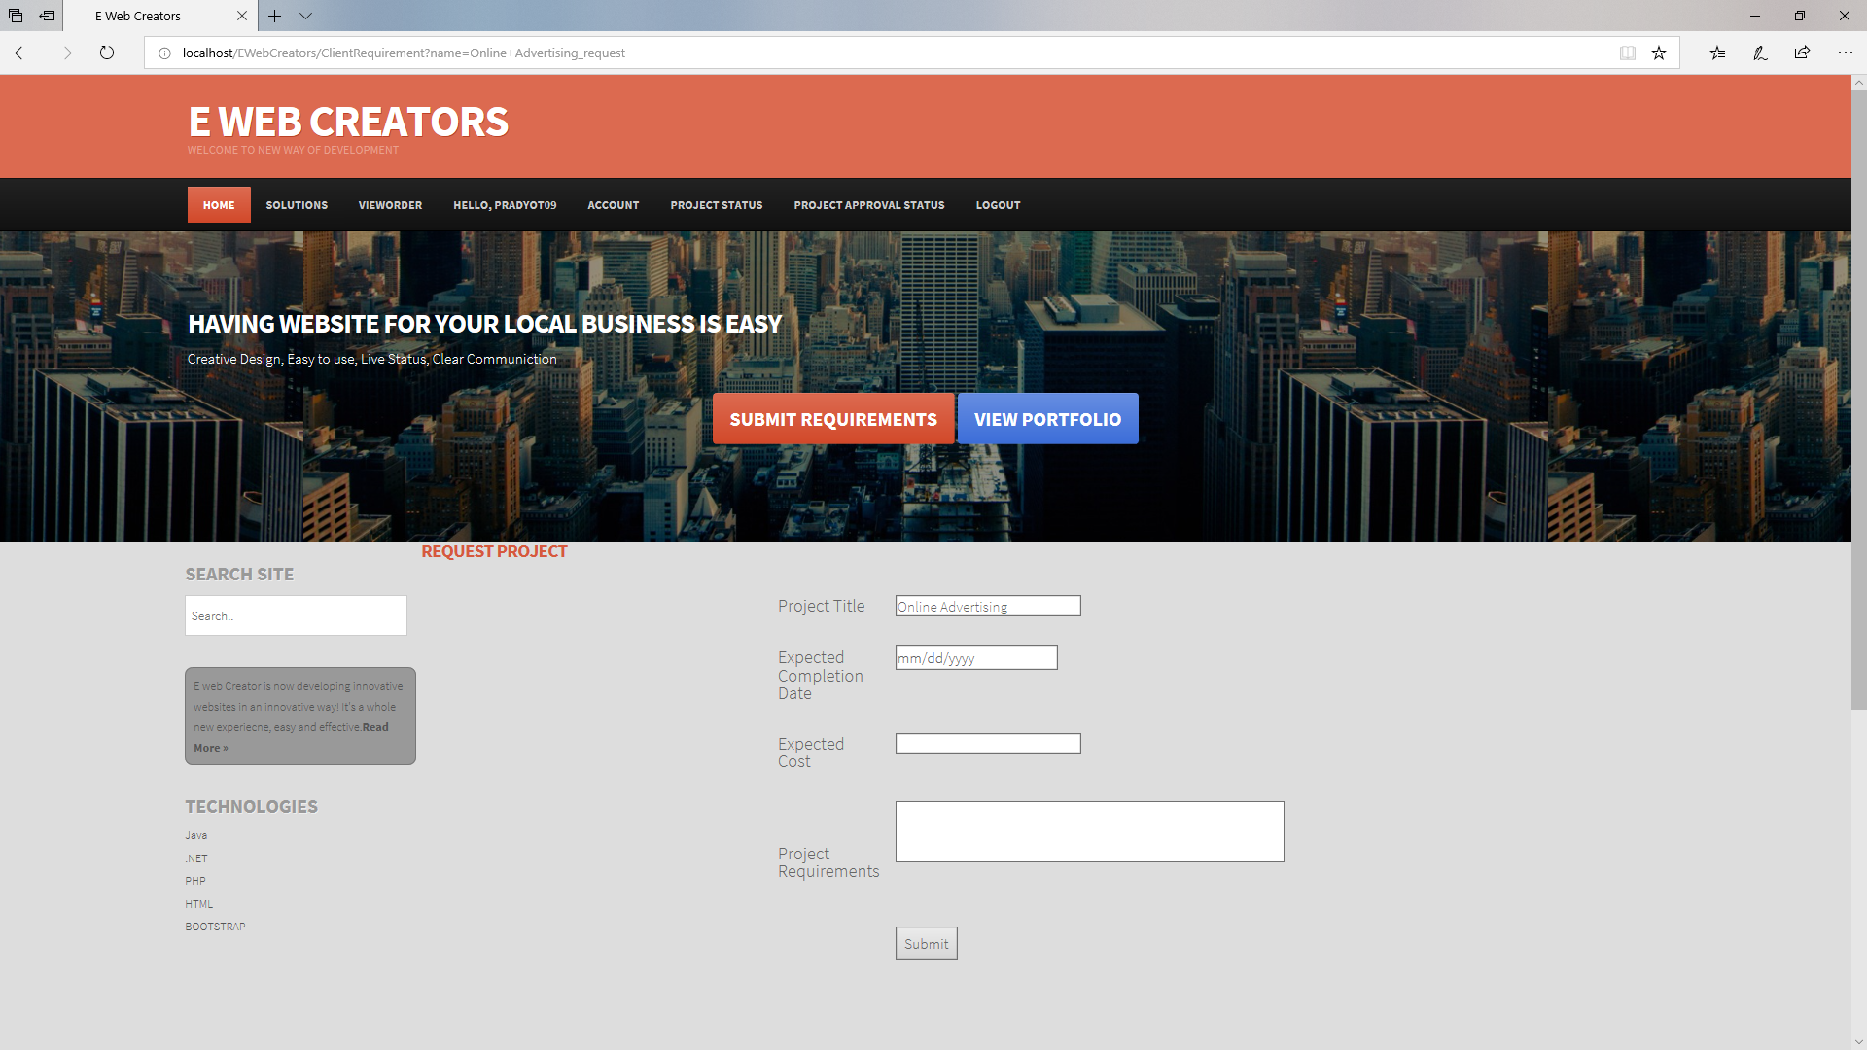
Request Project

Slide 17
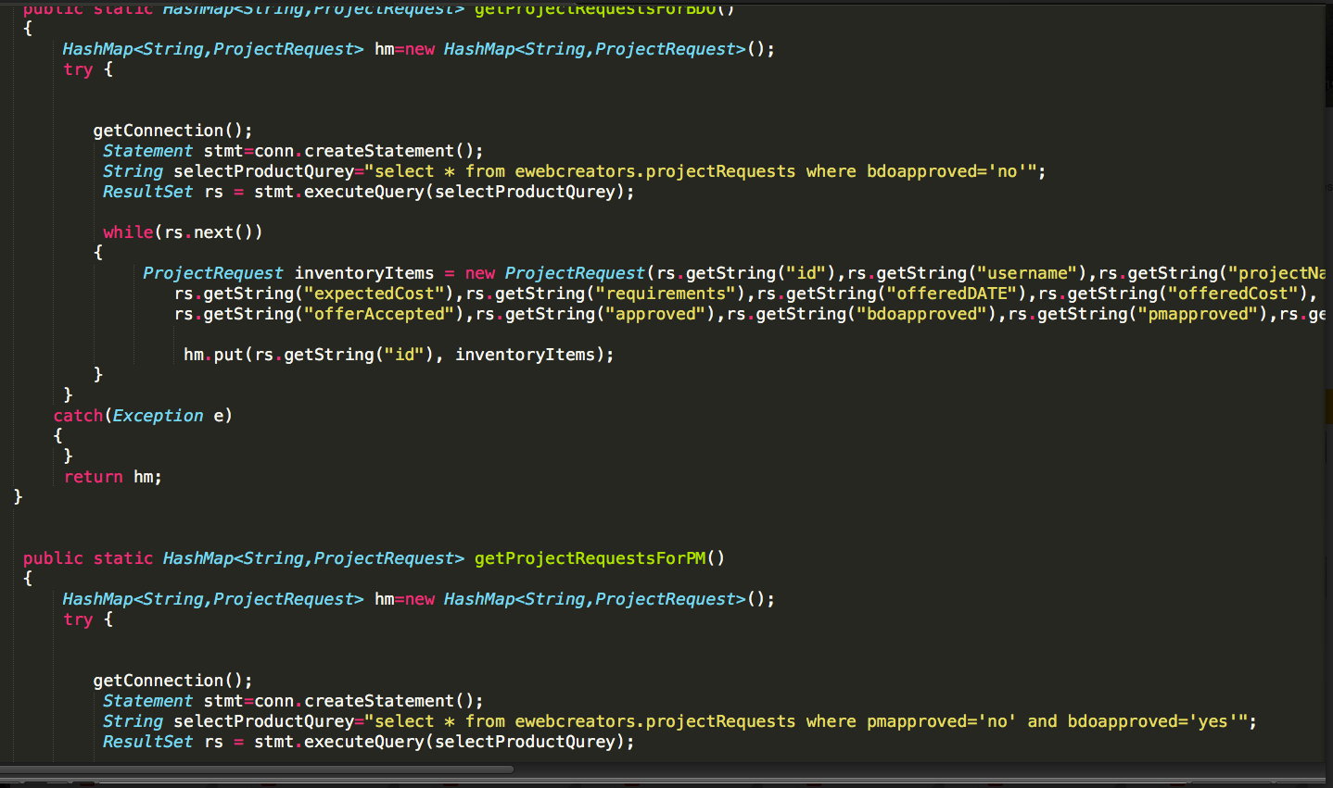
Code Snippet of Project Request Function PM And BDO

Slide 18
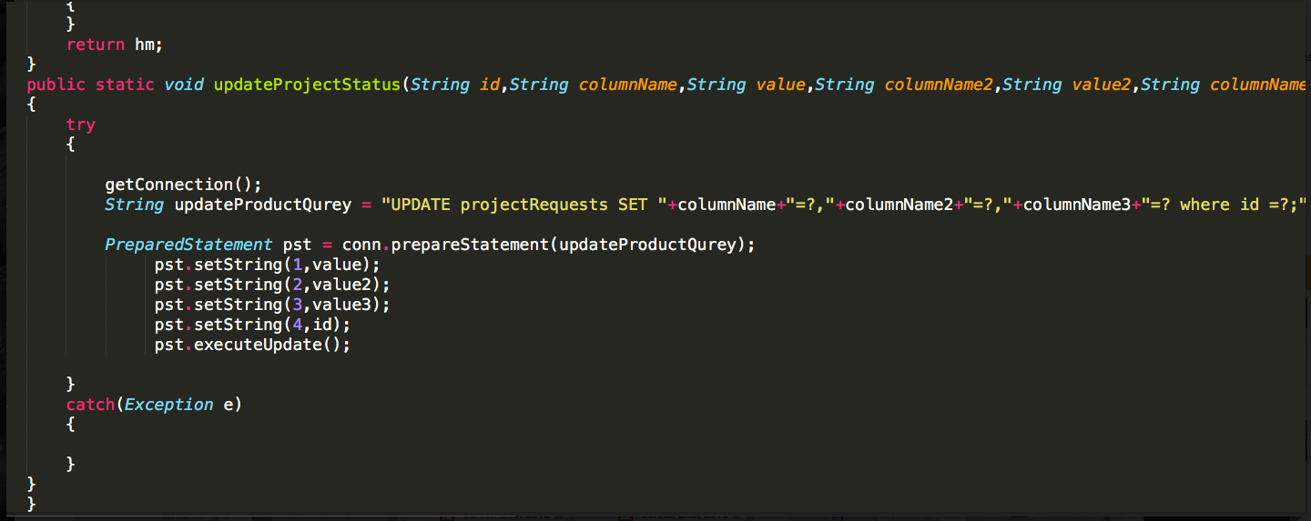
Update project Status Code Snippet

Slide 19
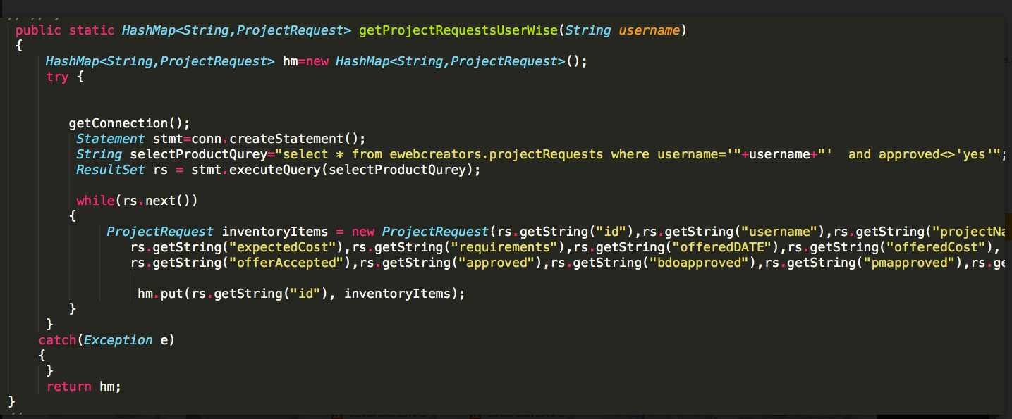
Project Request User Wise Code Snniepet

Slide 20
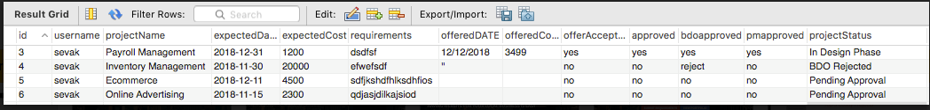
MySQL Project Details Tables

Slide 21
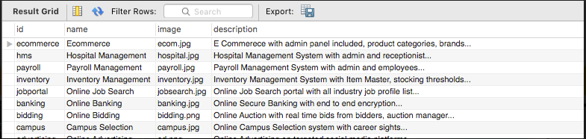
MySQL Product Details table

Slide 22
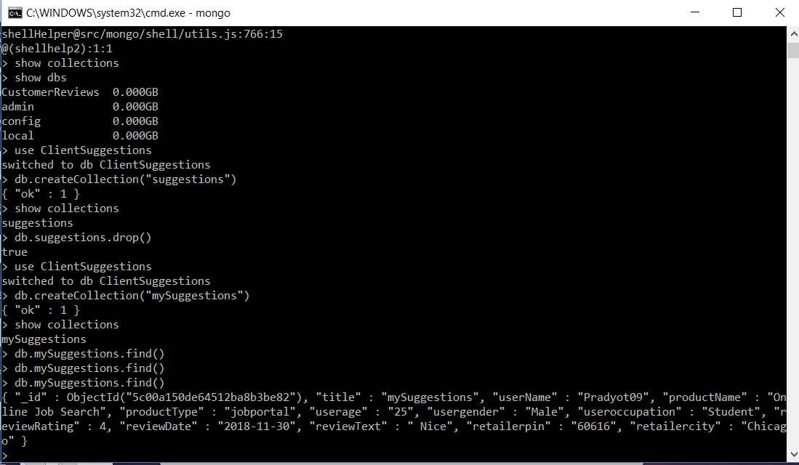
MongoDB for Suggestions

Slide 23
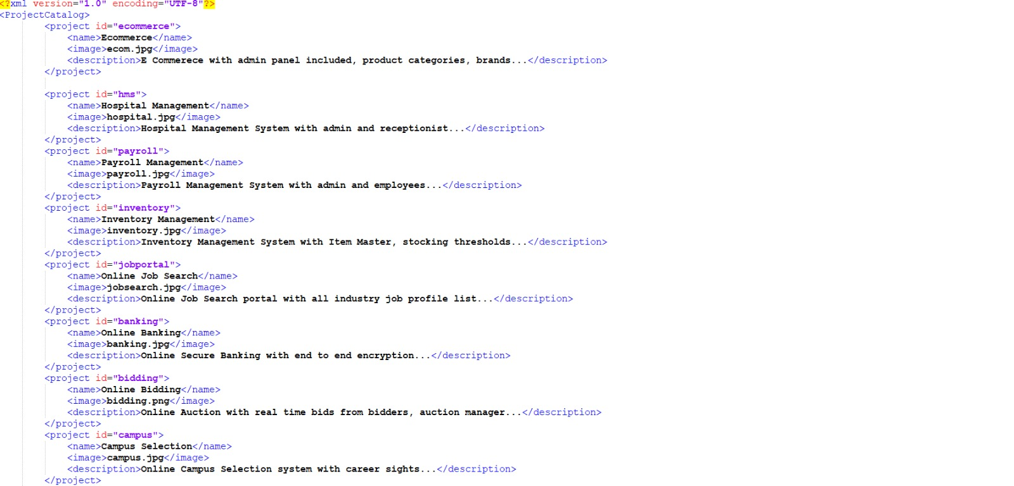
XML for Projects

Slide 24
Thank You
Questions?

